Slide 1
18PYB103J
SEMICONDUCTOR PHYSICS
MODULE 4
LECTURE 2 – FOUR POINT PROBE METHOD
LINEAR METHOD, VAN DER PAUW METHOD

Slide 2
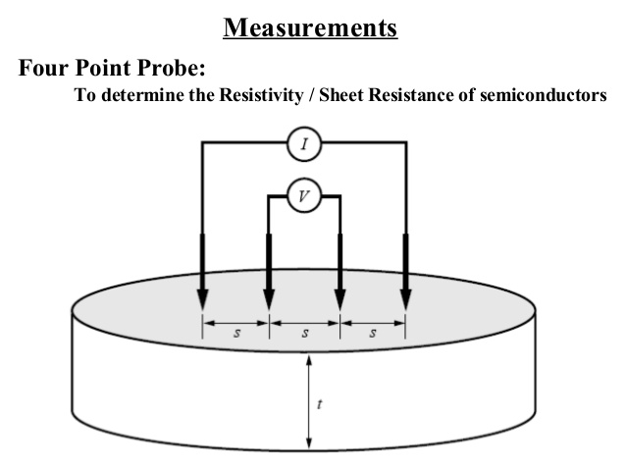
FOUR POINT PROBE METHOD
Two common techniques used in four-probe method are (i) Four-point collinear probe method and (ii) van der Pauw method
Schematic of four-point collinear probe method on bulk material.

Slide 3
Four-point collinear probe method:
This is the most common way of measuring the resistivity of a material, which involves four equally spaced probes as shown in Figure, in contact with a materials of unknown resistance.
This method can be used either in bulk or thin film specimen.

Slide 4
Four-probe method:
This method provides the measurement of the resistivity of the specimen having the wide variety of shapes but with uniform cross-section.
The soldering contacts proposed in two-probe method are replaced by pressure contacts
The potential difference developed across the inner probes, which draw no current due to the high input impedance voltmeter in the circuit, is measured through two inner probes.

Slide 5
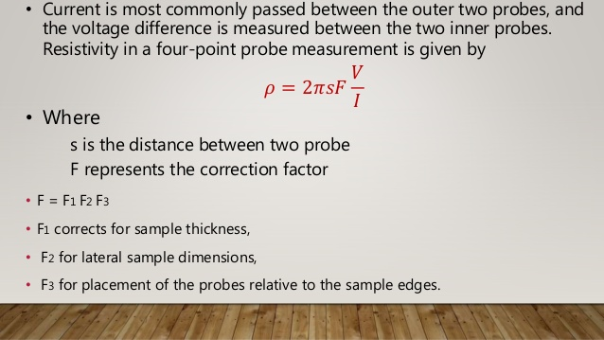
FOUR PROBE METHOD-RESISTIVITY

Slide 6
Four-probe method
In this method, four probes are utilized to measure the resistance of the samples. For example, two of the outer probes are used to send the current from the source meter and other two inner probes are used to measure the voltage drop across the sample.
The typical set up of the four-probe method is shown in Figure. There are four equally spaced tungsten metal tips supported by springs at one end to mount the sample surface without any damage.

Slide 7
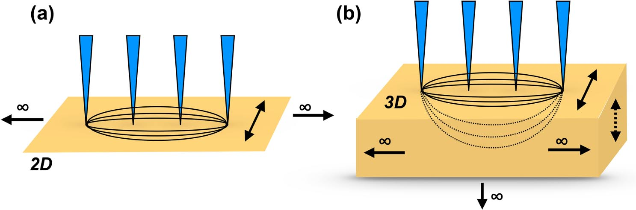
FOUR PROBE MEASUREMENT IN 2D AND 3D MATERIALS

Slide 8
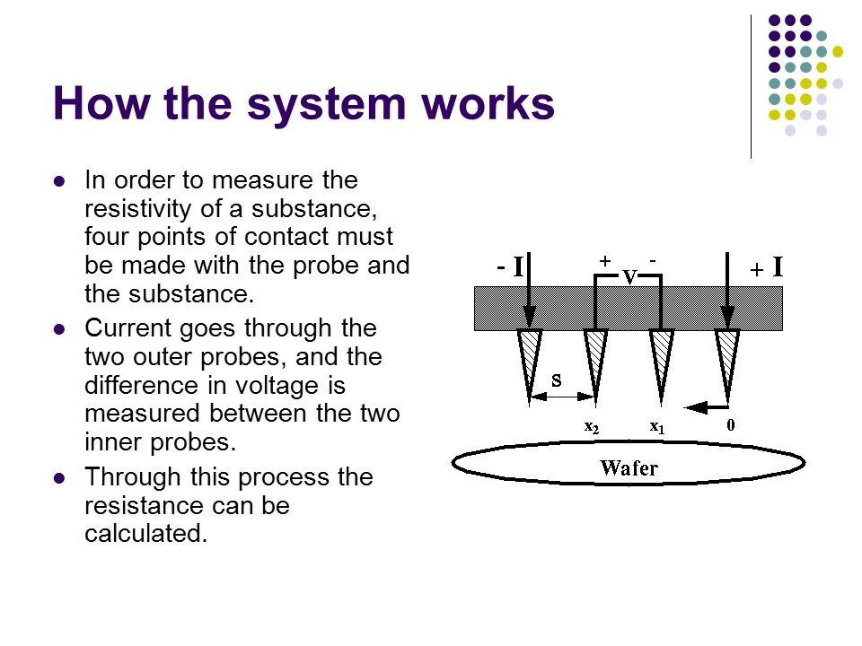

Slide 9
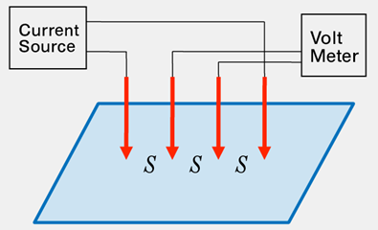

Four-probe method: For Thin sheet:
Four-probe method: For Thin sheet:
For a very thin layer as shown in Figure, where the thickness of the sheet t << the space between the probes, s, we can get current rings instead of spheres. Therefore, the expression for the area is A = 2πx.t. Therefore, the derivation for resistance turns out to be:
where probe spacing is uniform. Due to the superposition of current at outer tips, R = V / (2I ). Therefore,
Schematic of four-point collinear probe method on thin sheet.

Slide 10
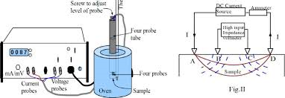
FOUR PROBE EXPERIMENTAL METHOD

Slide 11
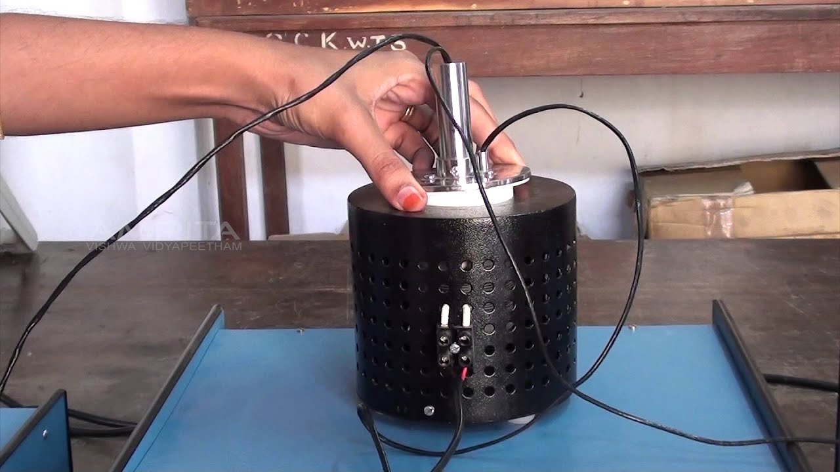
FOUR PROBE METHOD

Slide 12
Vander Pauw method
First propounded by Leo J. van der Pauw in 1958 [van der Pauw, Philips Research Reports, 13, 1958]
To measure specific resistivity and Hall-coefficient of arbitrarily shaped sample
From the measurements we can measure
-specific resistivity
doping type
- majority carrier density
- mobility of majority carriers

Slide 13
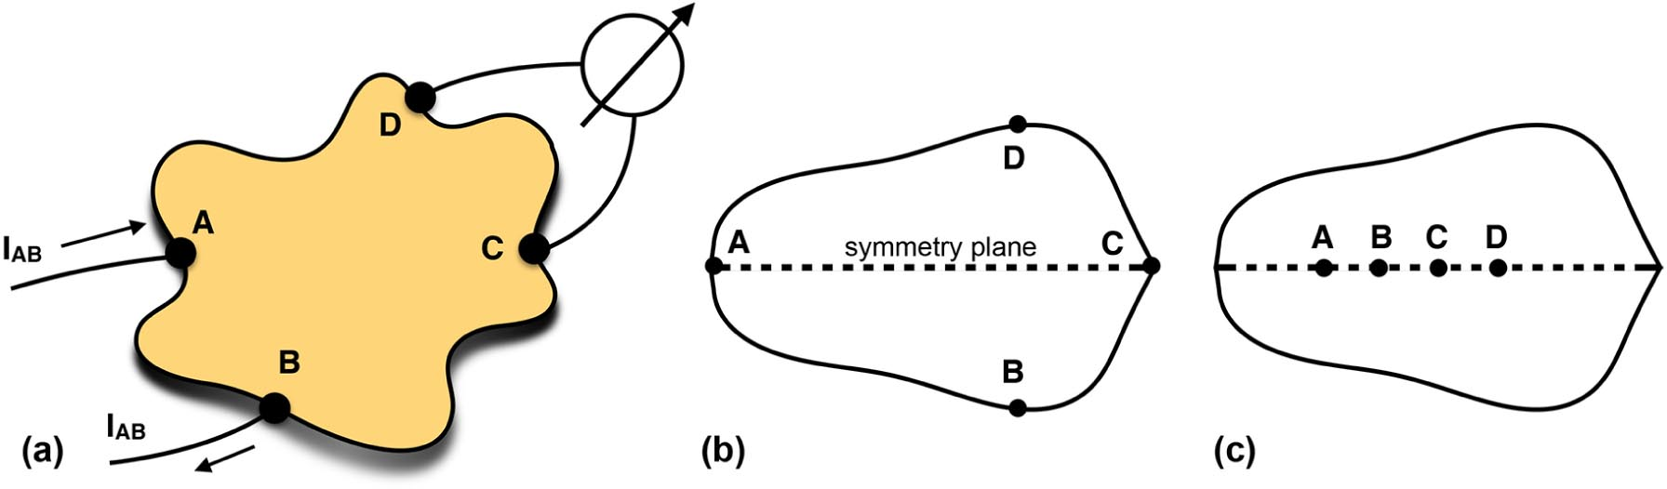

VAN DER PAUW METHOD

Slide 14
Vander Pauw method
The van der Pauw method is a technique commonly used to measure the resistivity and the Hall coefficient of a sample. There are five conditions that must be satisfied to use this technique:
The sample must have a flat shape of uniform thickness. The sample must not have any isolated holes.
The sample must be homogeneous and isotropic.
All four contacts must be located at the edges of the sample. The area of contact of any individual contact should be at least an order of magnitude smaller than the area of the entire sample.

Slide 15
Vander Pauw method
In order to use the van der Pauw method, the sample thickness must be much less than the width and length of the sample.
In order to reduce errors in the calculations, it is preferable that the sample be symmetrical. There must also be no isolated holes within the sample.

Slide 16
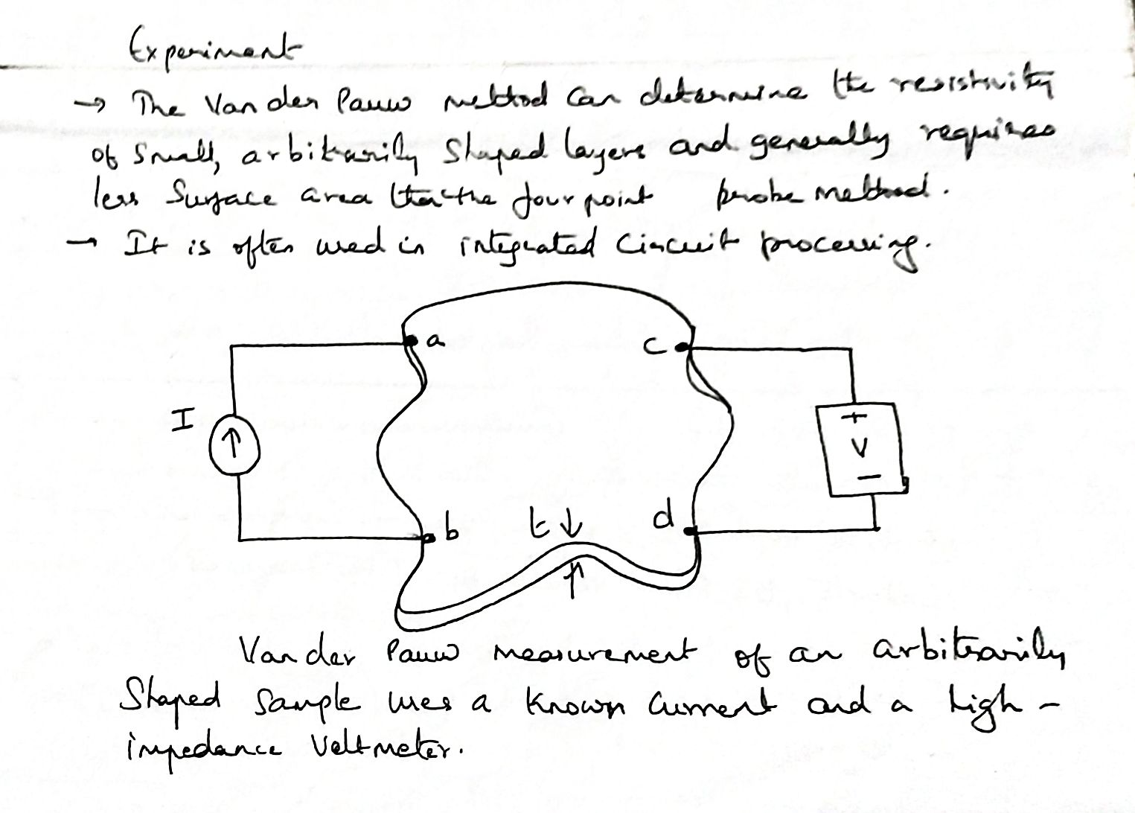
Vander Pauw method

Slide 17
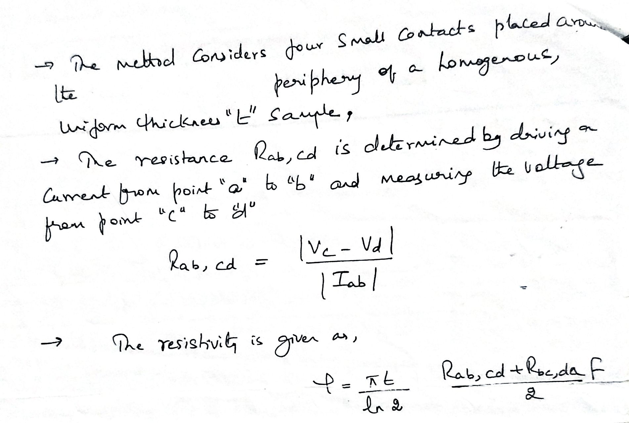
Vander Pauw method

Slide 18
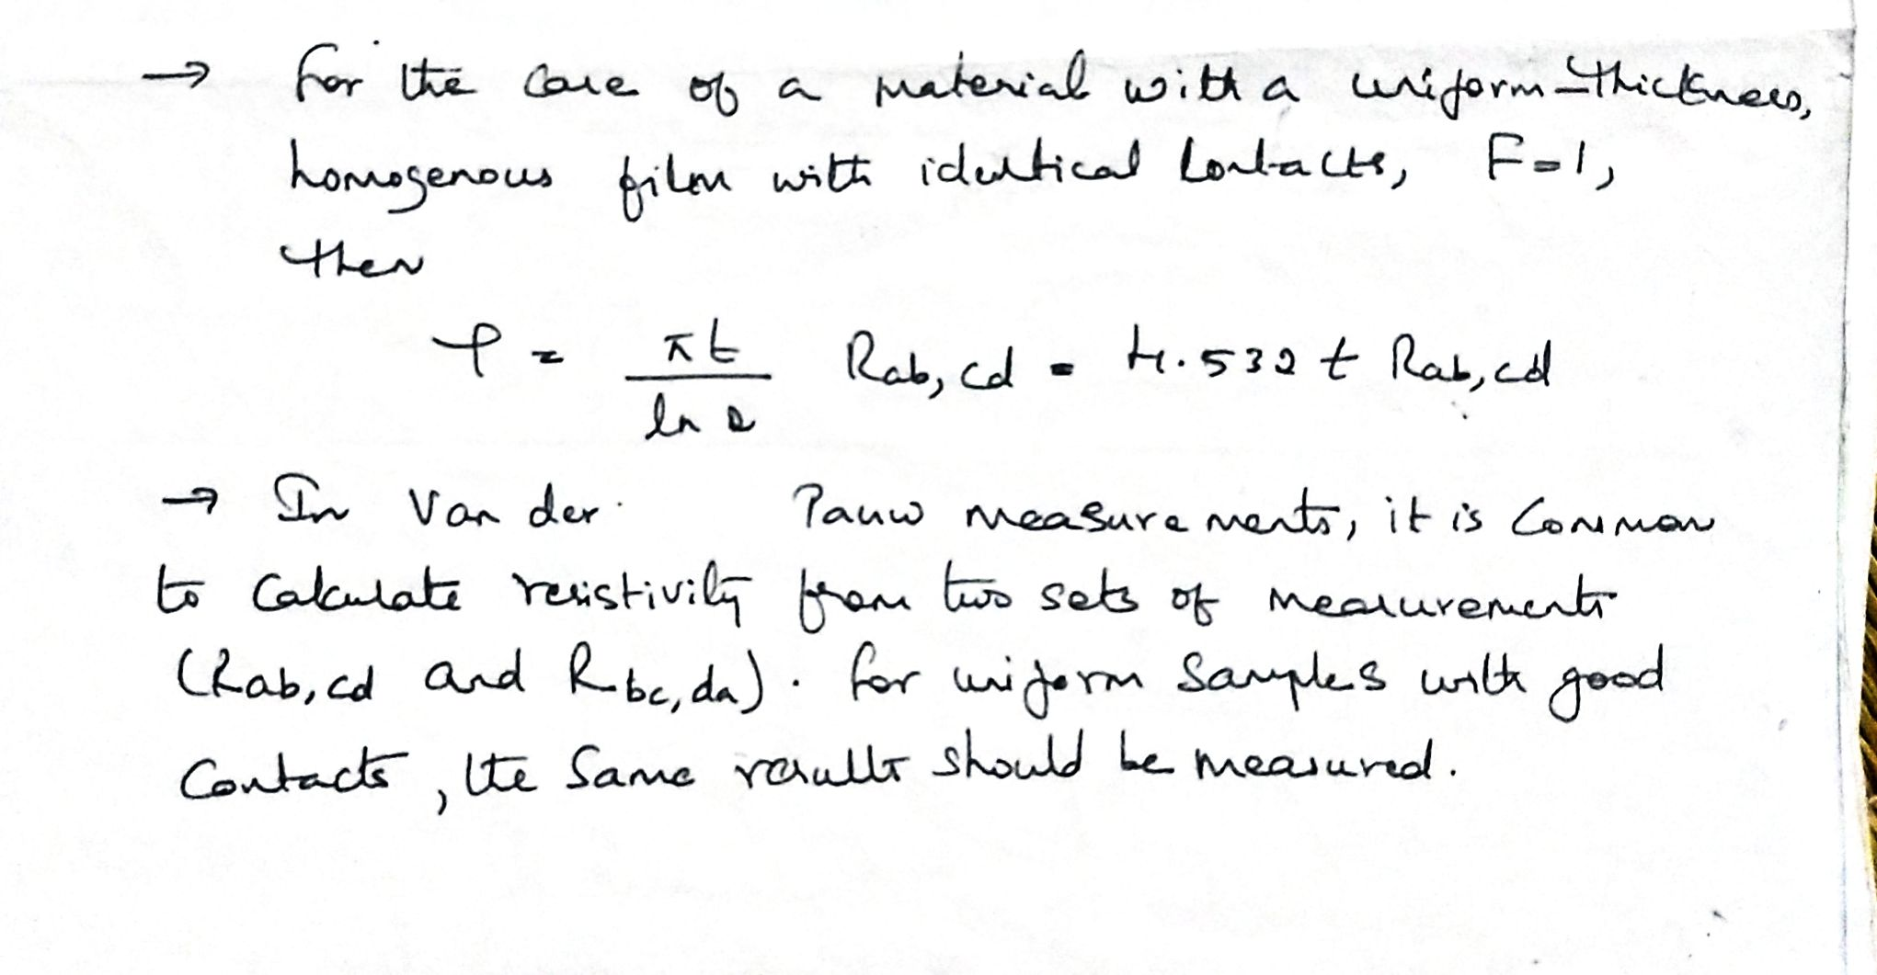
Vander Pauw method

Slide 19
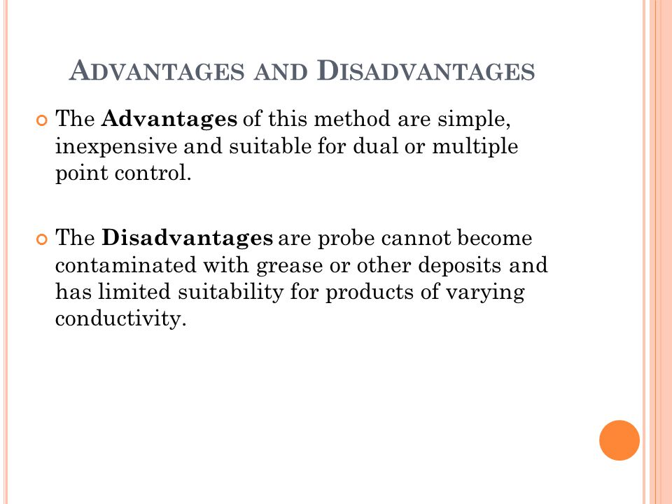

Slide 20
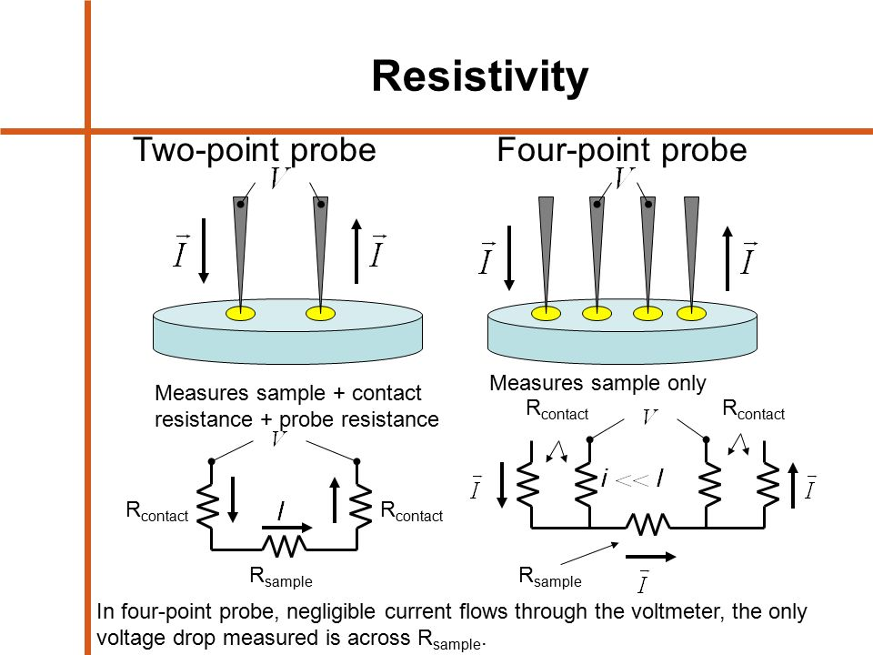
DENTAL IMPLANTS

Slide 21
Advantage of four probe method over two probe method
Four point probe is preferred than two-point probe as the contact and spreading resistances in two point probe are large and the true resistivity cannot be actually separated from measured resistivity.
In the four probe method, contact and spreading resistances are very low with voltage probes and hence accuracy in measurement is usually very high.

Slide 22
Advantage of four probe method over two probe method
To measure very low resistance values, four probe method is used.
The resistance of probe will be not be added to that of sample being tested.
It uses two wires to inject current in the resistance and another two wires to measure the drop against the resistance.

Slide 23


